Slide 1

Chocolate Bar Rating
Bhavya Reddy Patlolla

Slide 2

Agenda
Stakeholders.
Issues/Opportunities.
Data Explained.
Data Analysis.
Dashboards.
Summary.
Questions.
Reference.
This Photo by Unknown author is licensed under CC BY-NC.

Slide 3

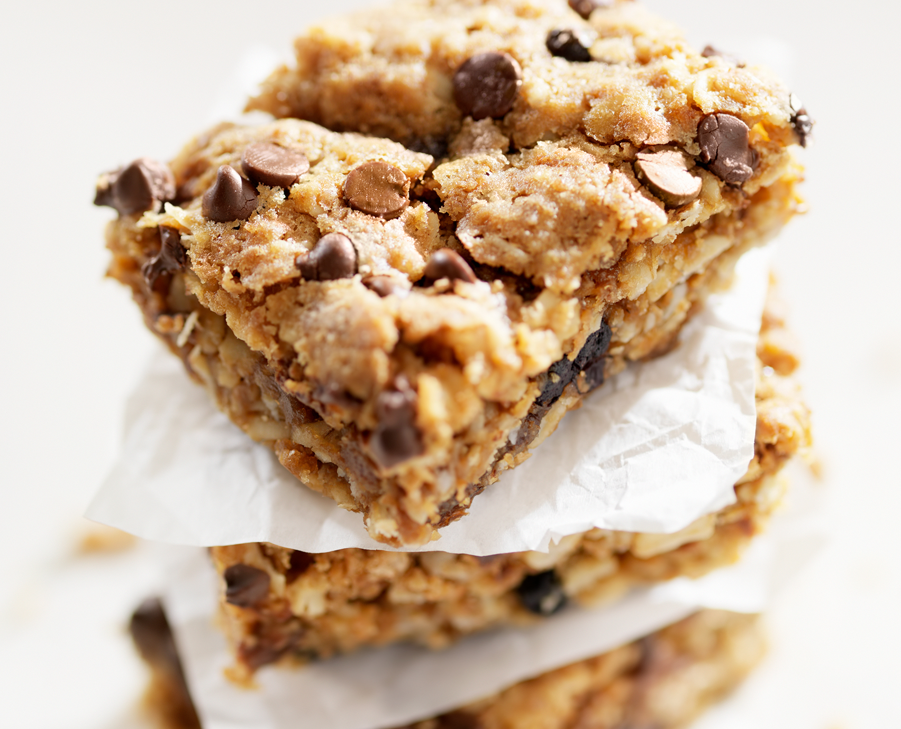
Stakeholders - Introduction
Chocolate bar rating gathers cocoa flavor data globally and rates it by location.
Stakeholders measures cocoa content per bean origin country for detailed location insights.
The customers act as stakeholders.
They can also view a review date from each country to experience the flavors.
Notes:
The idea is that each country has multiple locations to taste the cocoa flavor with added ingredients. The stakeholders can also view a review date from each country to experience the flavors.
With the help of company location, there are manufacturing companies where we can quickly get the analysis of different visuals.
In this slide here, I have used Freytag's pyramid to represent the story of how the dataset of chocolate cocoa gets rated for each ingredient by bringing the attention of the customers, and giving them to taste different flavors and concluding it by giving ratings according to the texture and the chocolate syrup.

Slide 4

Issue/opportunities
Opportunity - High cocoa flavor ratings lead to increased sales for manufacturers.
Issue - Loss in sales when the ingredients do not match with cocoa flavor.

Slide 5
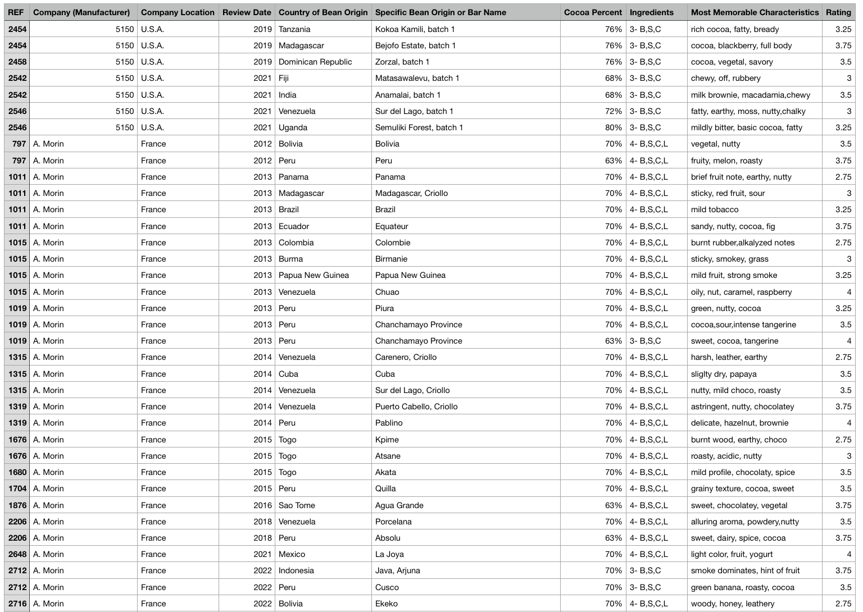
Data Explained
From Kaggle: Dataset: https://www.kaggle.com/datasets/nyagami/chocolate-bar-ratings-2022
The idea is that each country has multiple locations to taste the cocoa flavor with added ingredients.
With the flavors added, the ratings will be provided for each chocolate bar.
Notes:
The dataset content which I have chosen is from a credible source.

Slide 6

Best practices in data visualization.
Understanding the audience and their knowledge level.
Visualizations should be simple and easy to understand for audience.
By using the correct type of chart.
Choosing appropriate colors.
Labeling should be clear and concise.

Slide 7

KPIs
Overall rating.
Customer satisfaction.
Sales performance.
Quality.
Brand reputation

Slide 8
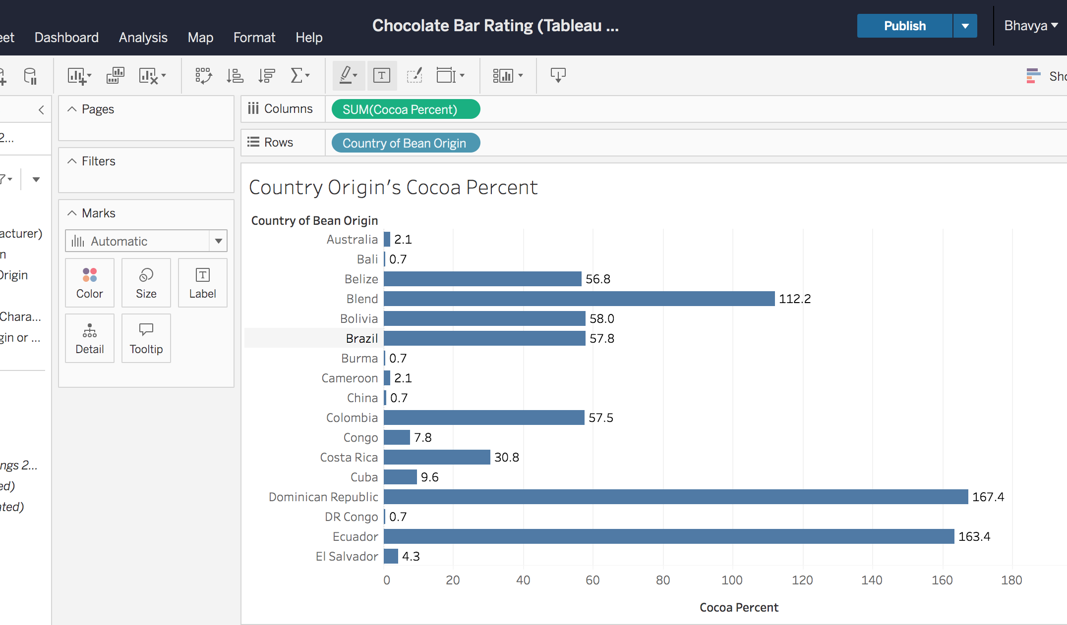
Data analysis – Bar Chart - Tableau
Bar chart represents each country's Cocoa percent.
This chart shows high-level insights with low analysis.
Notes:
I have used the Gestalt Principle of similarity and Continuity in this slide as it is representing similar colors, textures, or shapes for bars representing related data categories and arranging bars in a continuous line can help stakeholders group them together and see the progression or change in the data.
The size of individual bars can draw attention to specific data points and highlight differences between data categories.

Slide 9
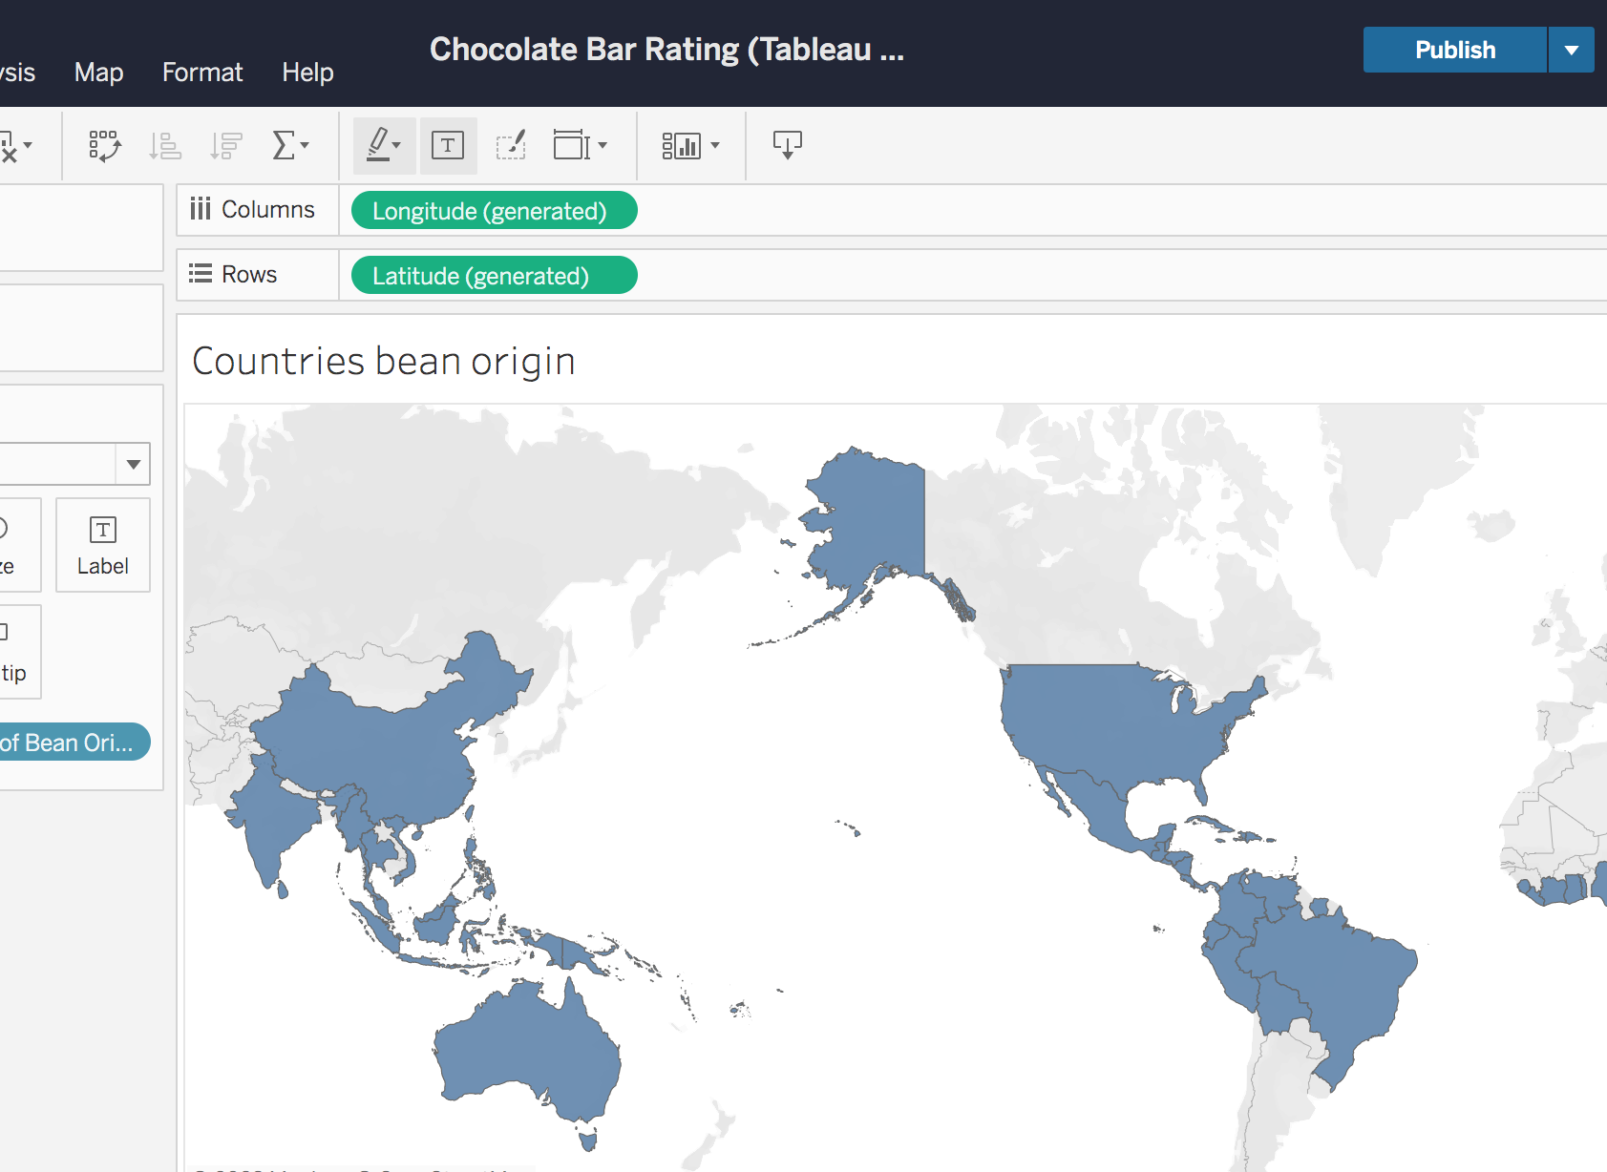
Geographical Chart - Tableau
This Geographical chart represents the origin of cocoa in various countries.
This chart gives detailed information with high analysis.
Notes:
I have used the Gestalt Principle of continuity in this slide because placing related areas next to each other and using continuous lines representing borders can help viewers understand the geographic relationships between the areas.
I focused on Texture because using different textures or patterns to represent different areas can help stakeholders/viewers distinguish between them even if they are similar in color.
Size: Changing the size of geographic elements, such as country borders or city markers, can draw attention to specific areas or data points.

Slide 10
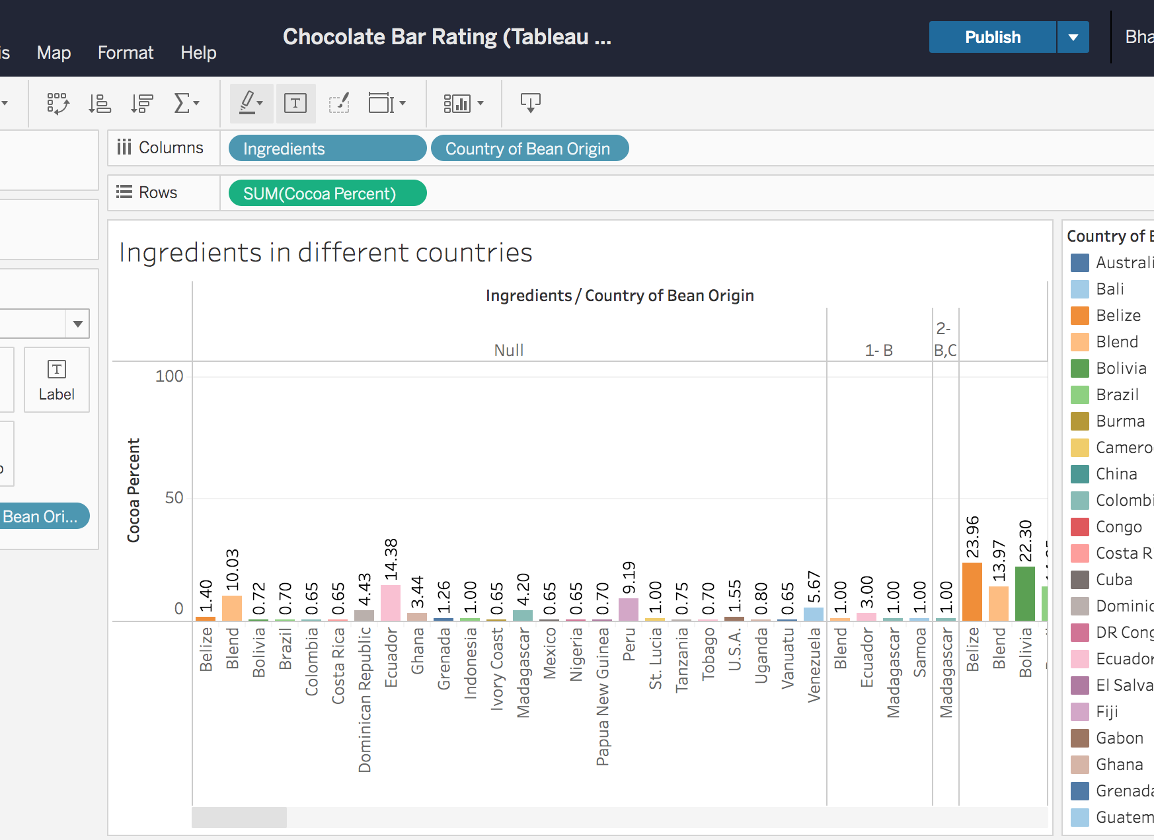
Column Chart - Tableau
This column chart represents the added ingredients in each country with the level of cocoa percent.
This chart shows high-level insights with low analysis.
Notes:
I have used the Gestalt Principle of Proximity: related columns which are together can help viewers see the Relationship between the data categories.
And Gestalt Principle of Similarity: Helps in identifying similar colors, textures, or shapes for columns representing related data categories can help viewers group them together.
In this chart I have showed Color using assorted colors to represent different data categories can help viewers quickly differentiate between them. The size of individual columns can draw attention to specific data points and highlight differences between data categories.

Slide 11
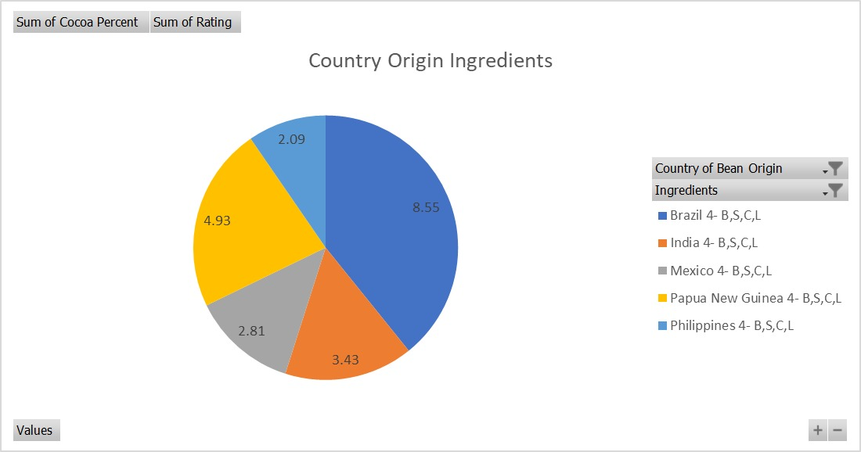
Pie Chart - EXCEL
This pie chart represents the ratings of ingredients and cocoa percent that is used at Country of Bean Origin.
This chart shows high-level insights with low analysis.
Notes:
I have used the Gestalt Principle of Similarity to bring out grouping with similar data categories, such as slices of similar colors or textures.
I have used Colors for each slice can help viewers quickly differentiate between them.
Changing the size of individual slices or the overall pie can draw attention to specific data points.
There is performance of shapes for each slice can help viewers distinguish between them even if they are similar in color or size.

Slide 12
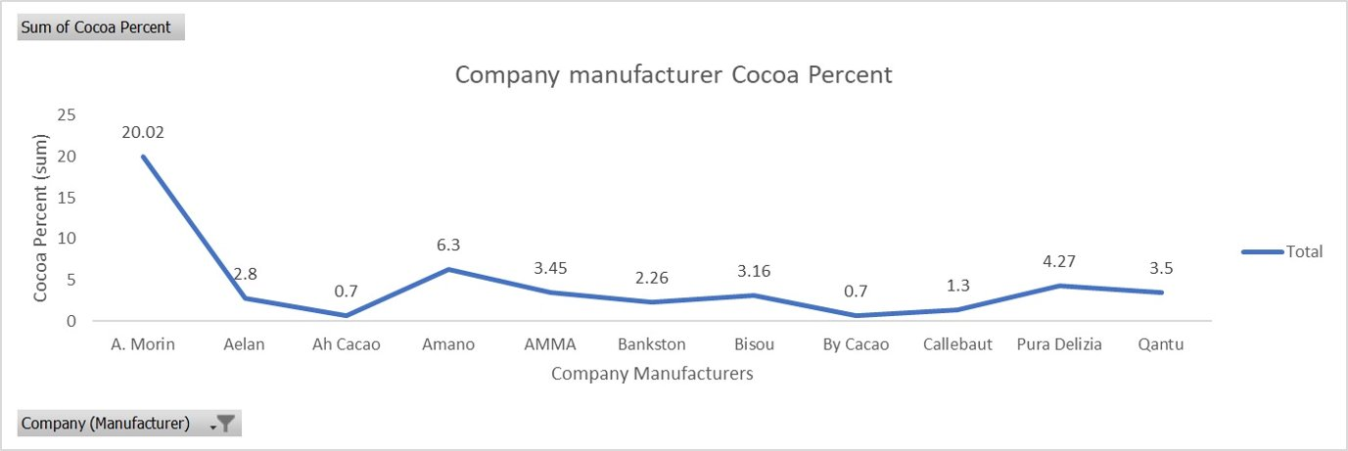
Line Chart - Excel
This line chart describes the sum of cocoa percent used at each company manufacturers.
This chart shows high-level insights with low analysis.
Notes:
In this slide I have used the Gestalt Principle of Continuity as this principle helps in Connecting data points with lines can help viewers see the progression or change in the data.
Gestalt Principle of Similarity: Using similar colors or line styles for related data categories can help viewers group them together and understand the relationship between them.
The pre-attentive attribute that occurred for this line chart is the color as representation of data can help viewers distinguish between them and understand their relationship.

Slide 13
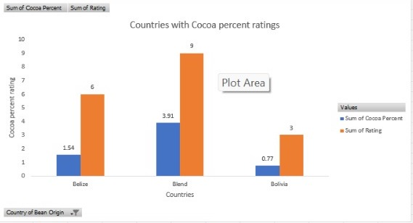
Side by side Bar Chart - Excel
This stacked column chart represents the sum of cocoa percent with rating in different countries.
This high-level insights chart helps in identifying the ratings and cocoa percent in each different country.
Notes:
I have used the Gestalt Principle of Proximity: Grouping related bars together can help viewers see the relationship between the data categories.
Gestalt Principle of Similarity: Using similar colors, textures, or shapes for bars representing related data categories can help viewers group them together.
Gestalt Principle of Closure: This bar chart helps viewers understand the total value and the contribution of each data category.
I have used different colors to represent different data categories can help viewers quickly differentiate between them.
And the position of bars relative to each other can show the comparison between the data categories.
The length of individual bars can draw attention to specific data points and highlight differences between data categories.
For this chart, To drive the audience's energy towards global cocoa ratings, I have used warm hues in my presentation.

Slide 14

Best Practices - Dashboard
I have designed according to audience comfort with efficient designs.
I have used Common charts to represent my dataset.
I have used Consistent colors, fonts for professionalism.
I looked out in keeping the dashboard up to date and relevant.

Slide 15
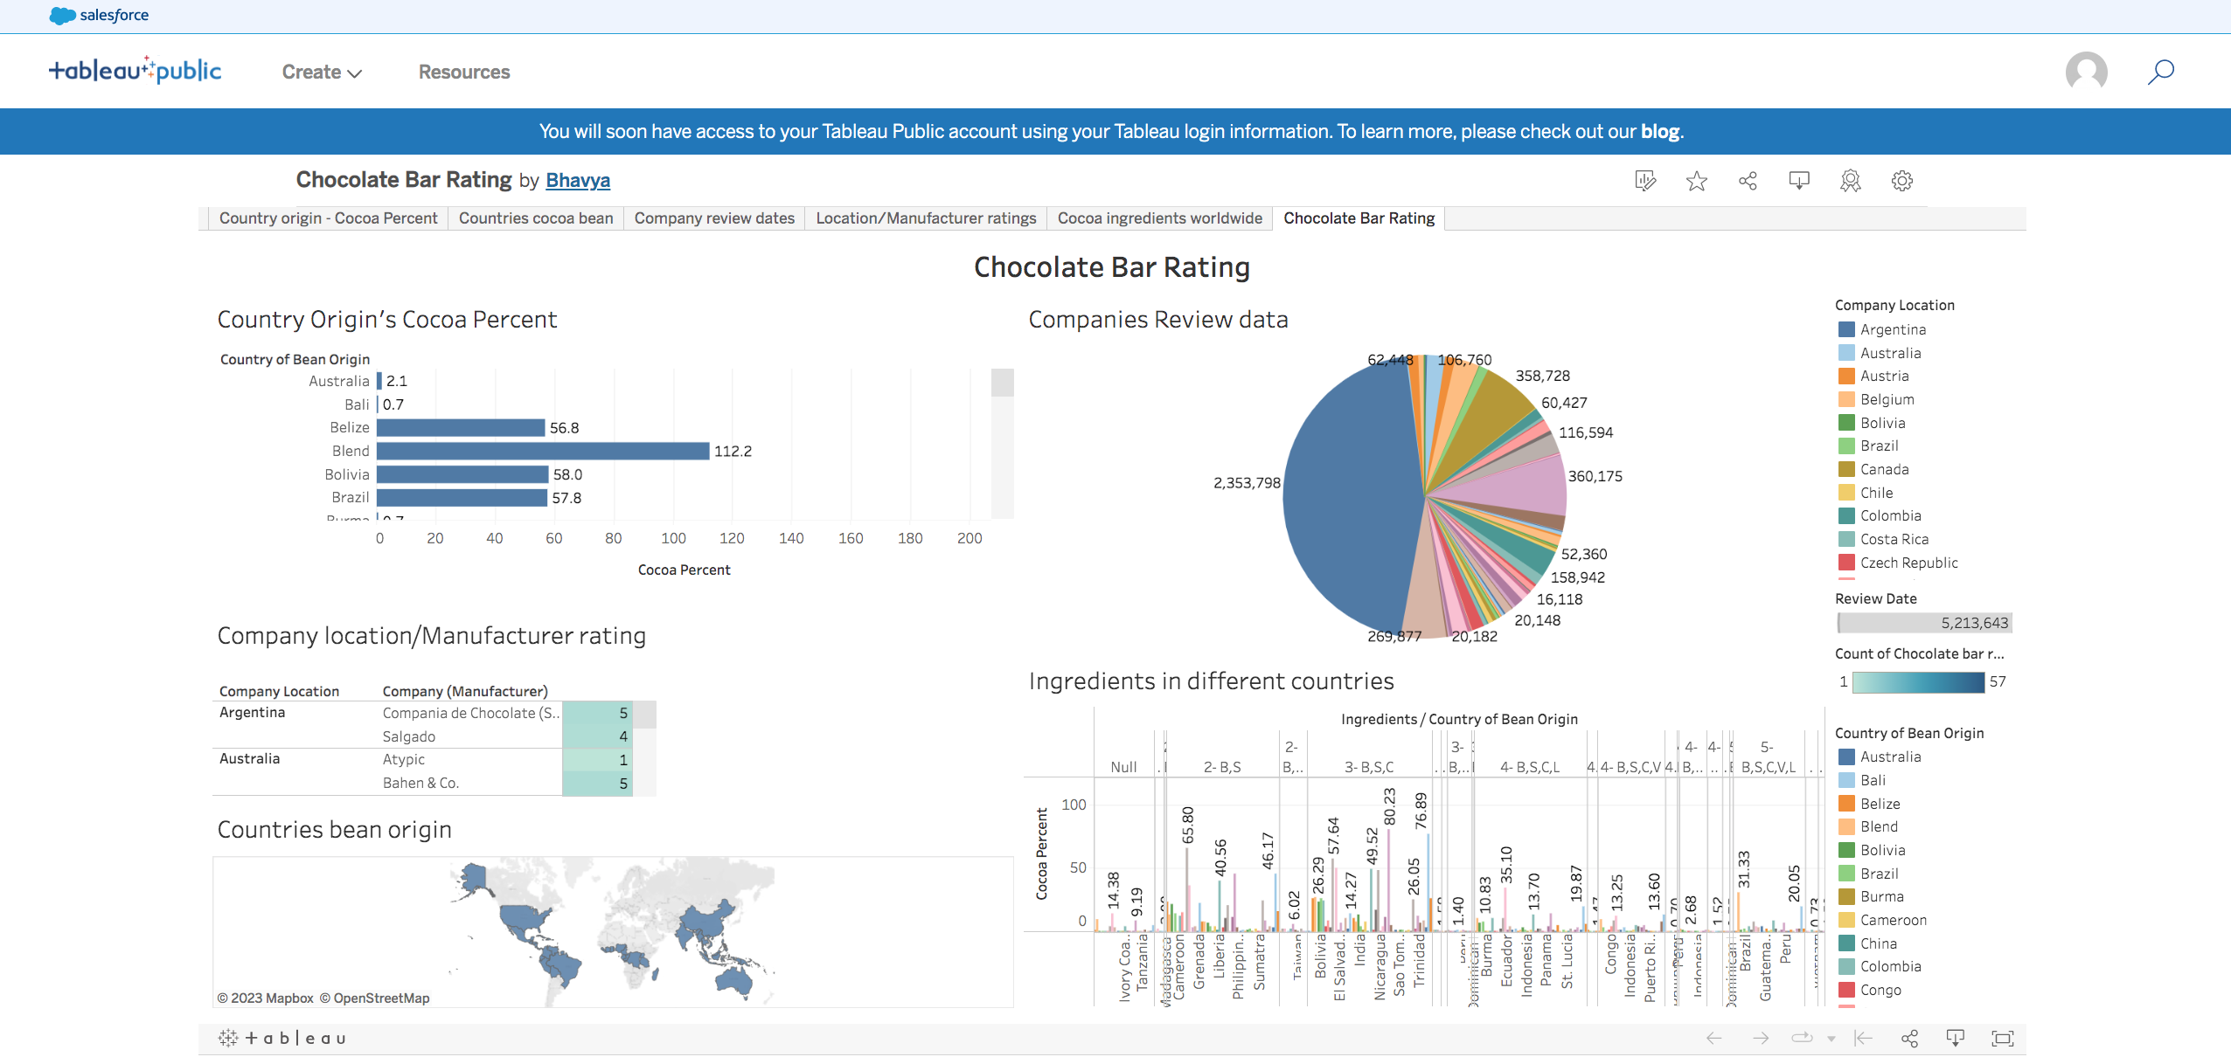
Chocolate Bar Rating Dashboard
Notes:
Gestalt principle of Closure: Because this principle is used to show relationships between different parts of the data.
I have focused on Size, shape, and position for this tableau dashboard, using different colors and charts for good graphics. I even tried to explain the content of the dataset. I have given other representations of charts with filters applied to each chart. I have chosen outstanding presentation designs to implement Aristotle's triangle as it will be clear for the person viewing the dashboard.

Slide 16
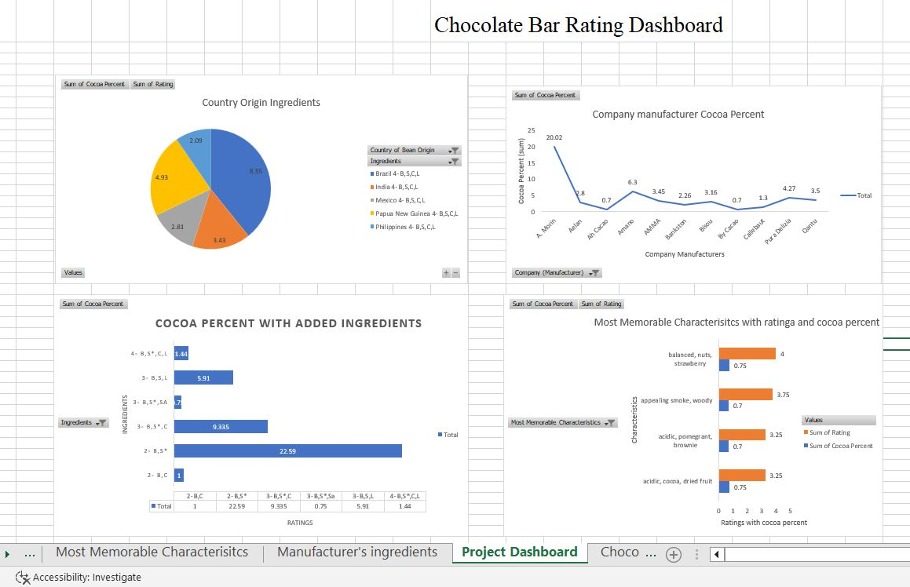
Chocolate Bar Rating Slides(1)
Notes:
Gestalt principle for this Dashboard slide is the Gestalt principle of similarity: It can group similar data points.
I have represented Color as it is used to draw attention to specific data points or to indicate different categories or values. However, it's important to use color consistently and sparingly to avoid overwhelming the dashboard with too much visual noise.
And size is used to indicate the relative importance of data points or to draw attention to specific values. Larger sizes can make certain data points stand out and grab the user's attention.
The Shape can be used to indicate different categories or to convey specific meaning. For example, different shapes can be used to represent different types of data or to represent specific icons or symbol.
.

Slide 17
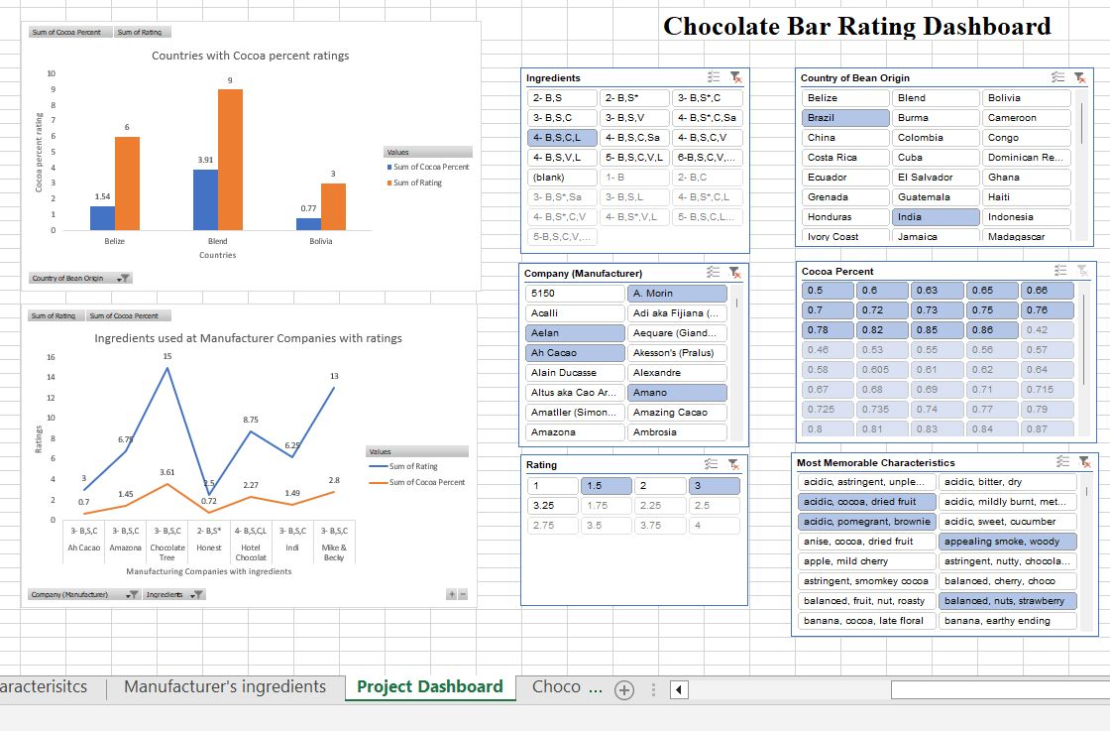
Chocolate Bar Rating Slides(2)
Notes:
Finally, in this excel dashboard, I have displayed different data visualizations by implementing strategies for aligning each chart's data labels and increasing the data-ink ratio for easy eyesight. I have implemented color psychology for each chart to draw the attention of the audience. I have also used font and the content in clear view to make it visible and efficient to the audience

Slide 18
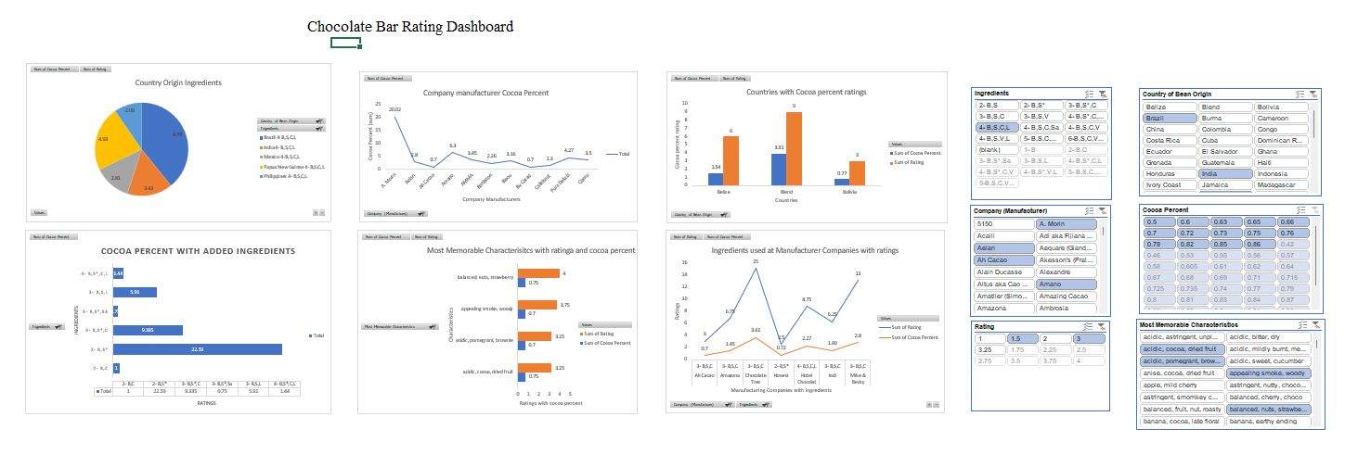
Chocolate bar Rating Dashboard
Notes:
This chart contains 6 different charts.
I have added slicers to get the results from different locations.

Slide 19

Summary
Chocolate bars are rated 1-5 on quality, flavor & texture.
Customer ratings help improve cocoa quality.
We can quickly identify various data patterns by utilizing appropriate charts in the dashboard.
Filters incorporate into the dashboard enhance its informational value and allow the audience to view data from the most relevant perspective.
The performance of key performance indicators (KPIs) in the chocolate bar rating is shown through ingredients, texture, and cocoa quantity, which aid in determining the top rating of cocoa flavor.

Slide 20

Questions?
Email: patlollb@csp.edu
Mobile No: 612-685-9032

Slide 21
References
Dataset:
https://www.kaggle.com/datasets/nyagami/chocolate-bar-ratings-2022
Jeffrey D. Camm; James J. Cochran; Michael J. Fry (2022). Data Visualization: Exploring and Explaining with Data.

Slide 22


